Slide 1
The Benefits of a Vulnerable .NET App
Nick Gilbert

Slide 2

About Me
From Gilford, New Hampshire
Senior, Studying Computer Science
.NET Developer for Clearspan Components (2014-2016)
Interned at CTS, Inc (2016)
Enjoy Skiing and Sailing

Slide 3
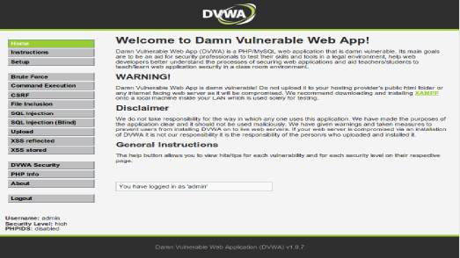
About This Project
DVWA
PHP/MySQL – one of many combinations available
COS492: SIP in Computer Science
Cyber Security and Software Development concentrations

Slide 4
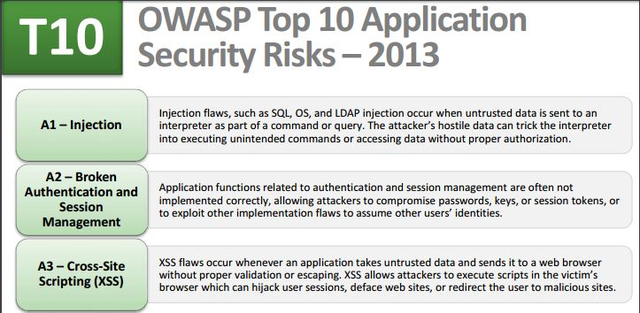
Objective
Vulnerable .NET App (VDNA)
Demonstrates top 3 security risks as determined by OWASP
XSS Attacks
SQL Injection
Vulnerable Authentication

Slide 5
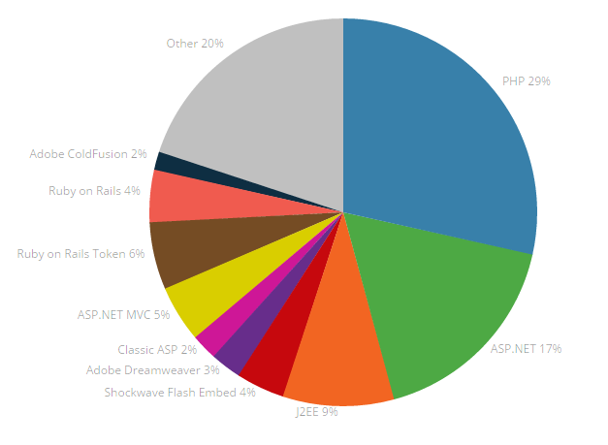
Approach
Why C#.NET/Microsoft SQL
It’s Awesome
It’s Widely Used
Role of Frameworks
Visual Studio 2015 Community
SQL Server Management Studio
Github

Slide 6
Demonstration

Slide 7
Conclusion
Important to write secure code, especially in web applications
A lot more can be added
Github: nickgilbert1994

Slide 8


